Slide 1
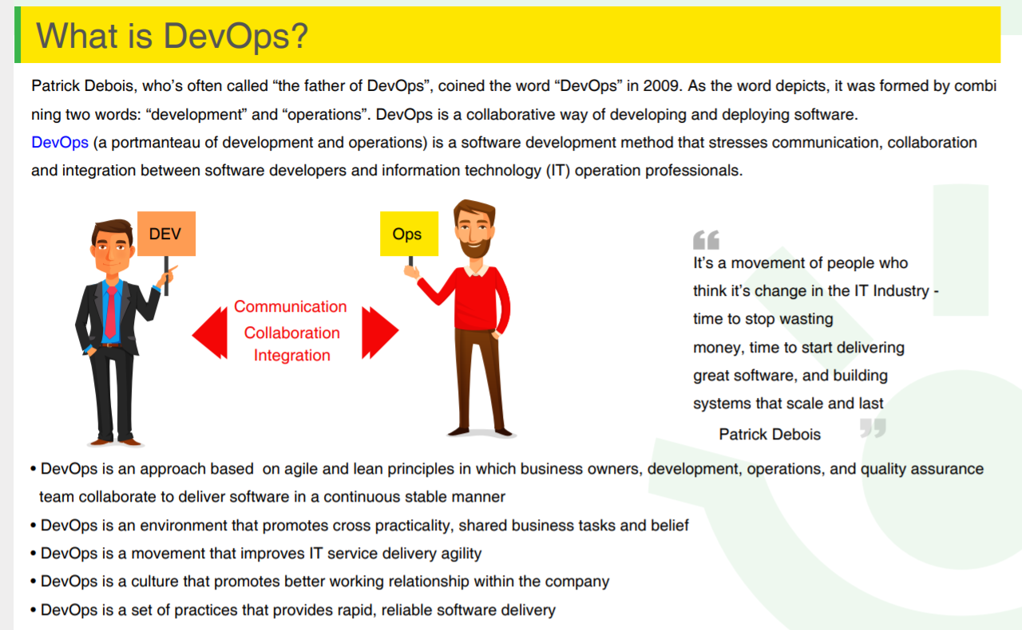

Slide 2
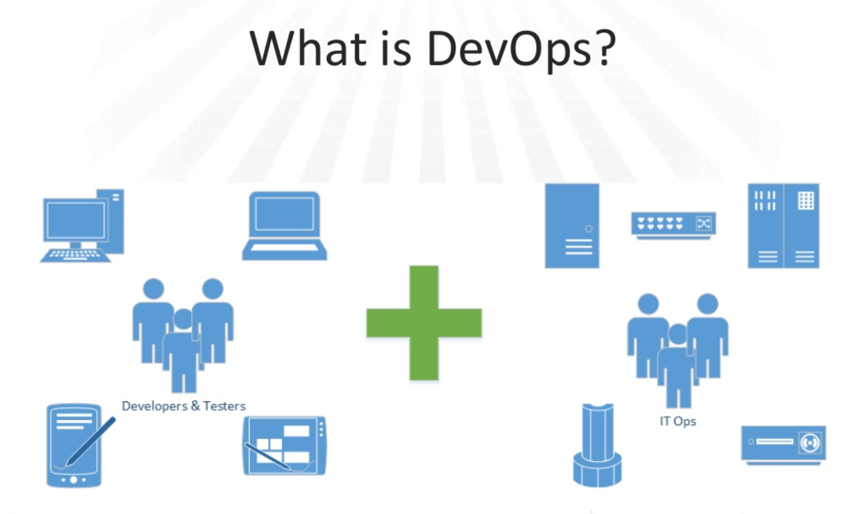

Slide 3
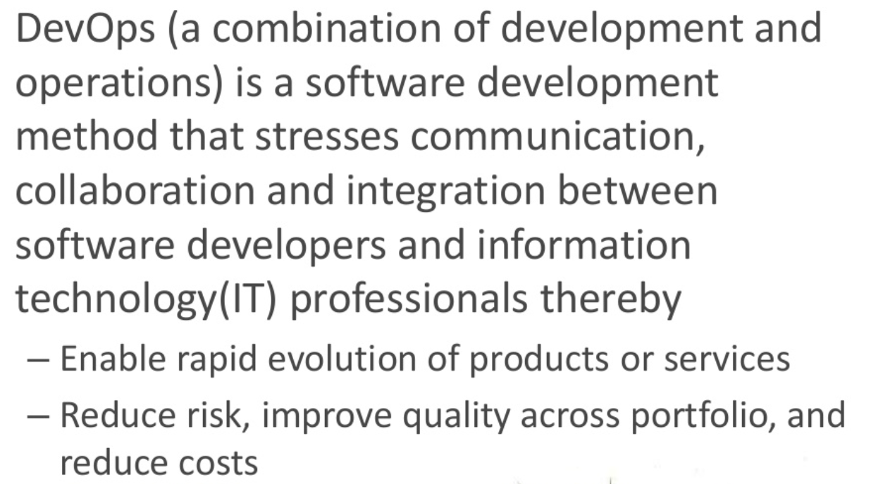

Slide 4
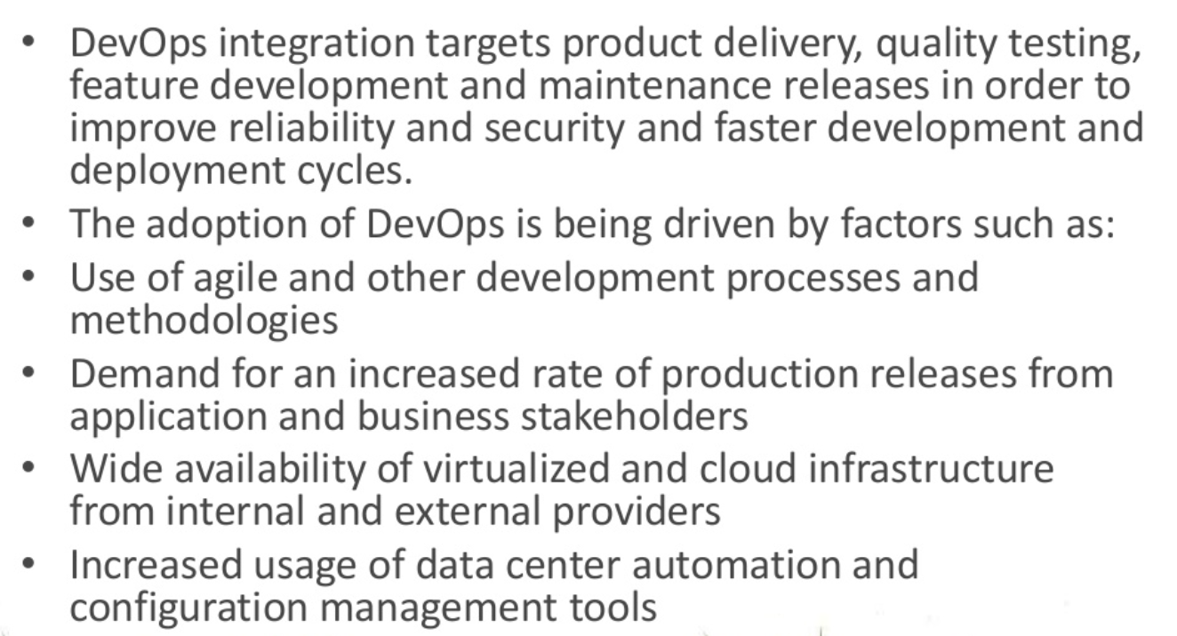

Slide 5
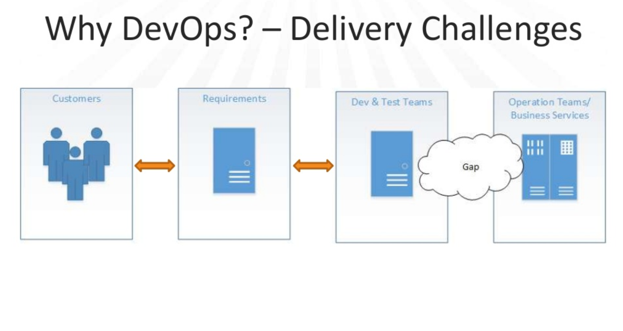

Slide 6
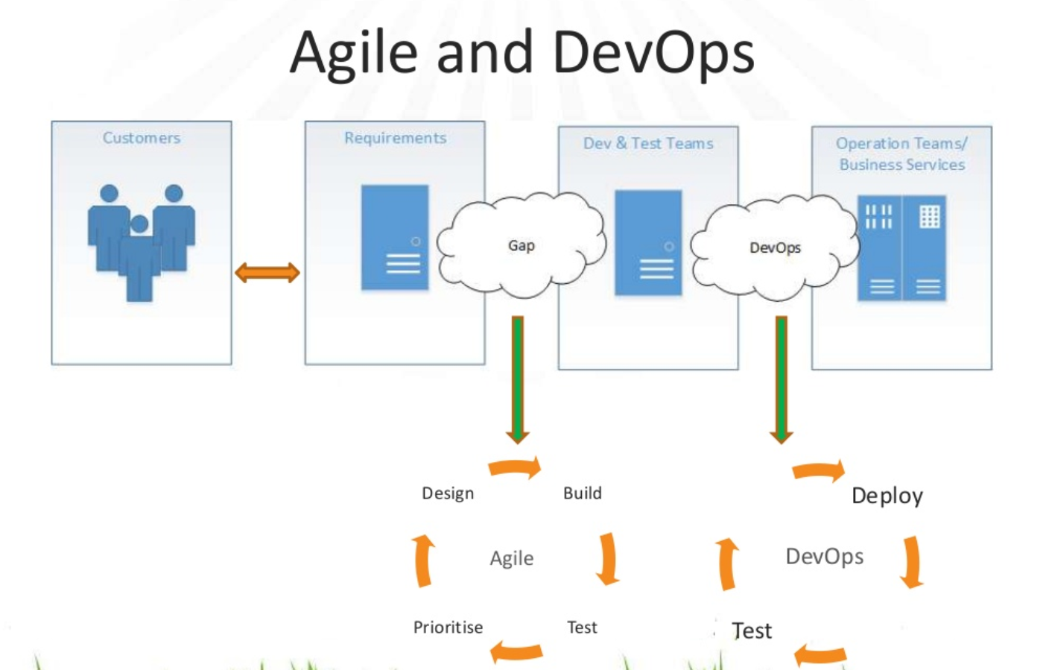

Slide 7
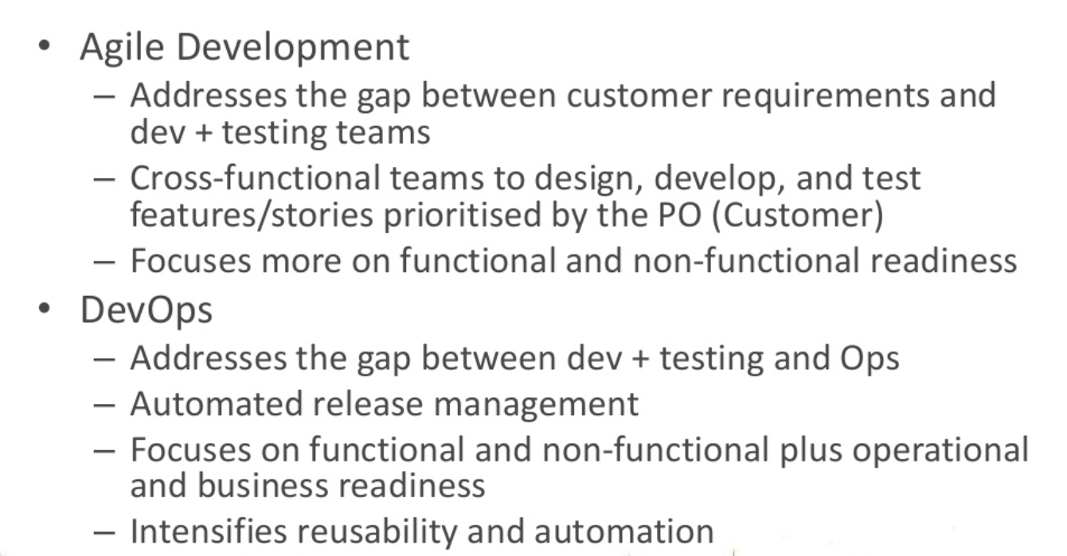
Agile and DevOps

Slide 8
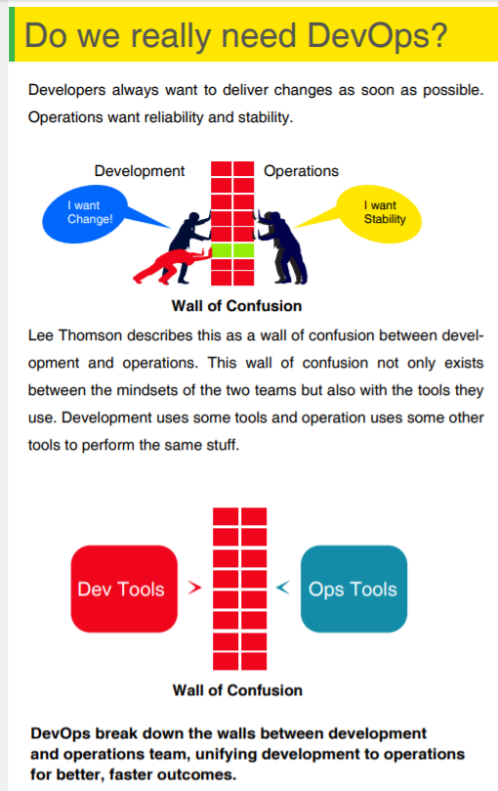

Slide 9
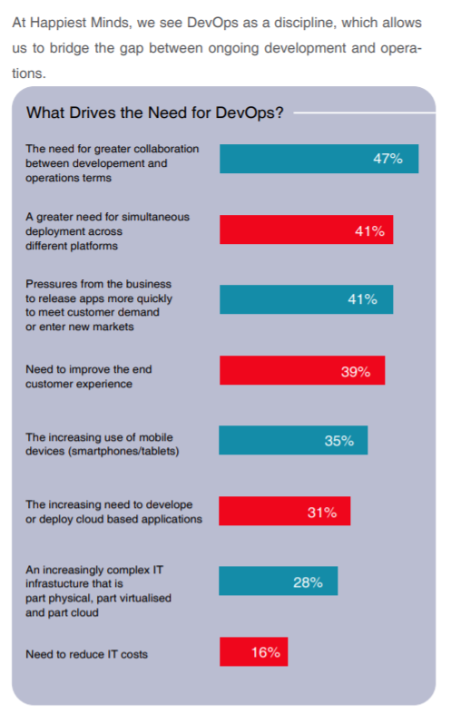

Slide 10
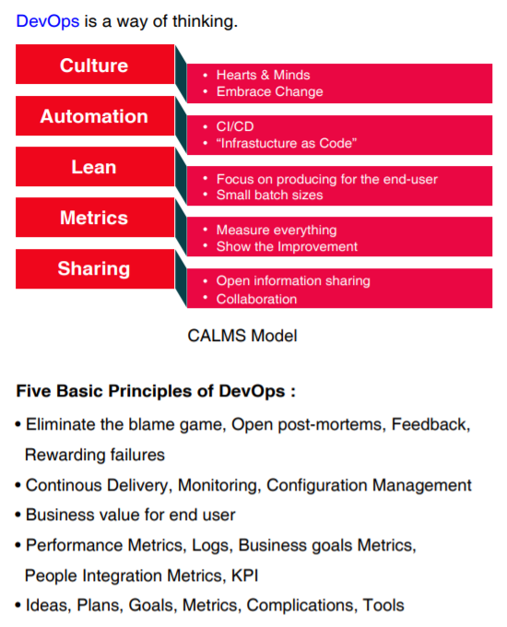

Slide 11
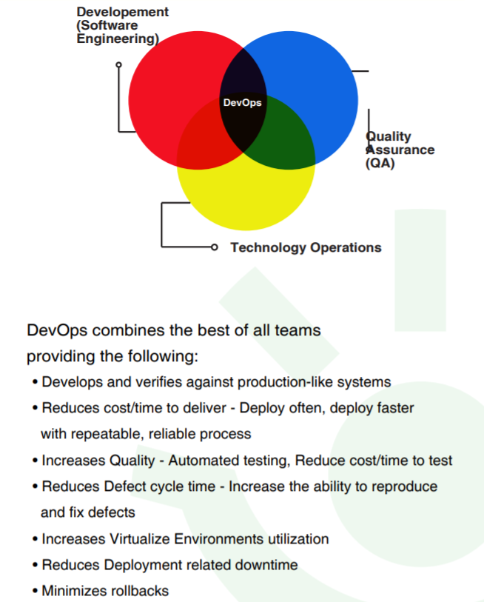

Slide 12
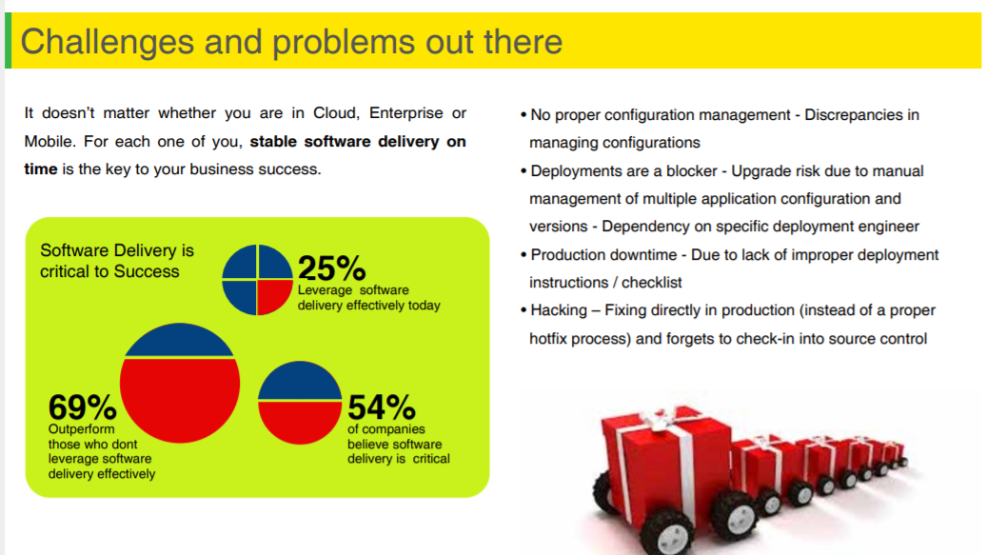

Slide 13
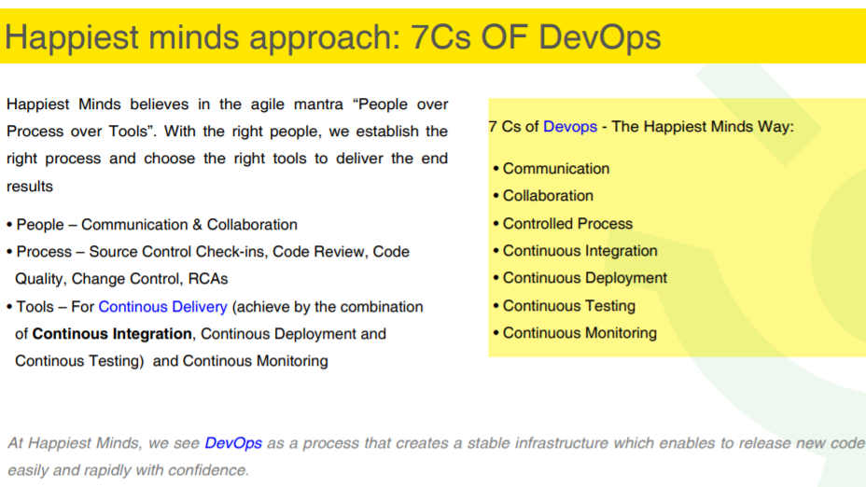

Slide 14
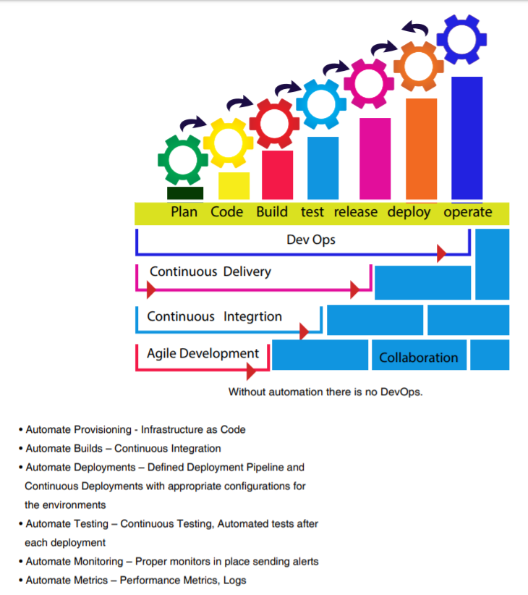

Slide 15
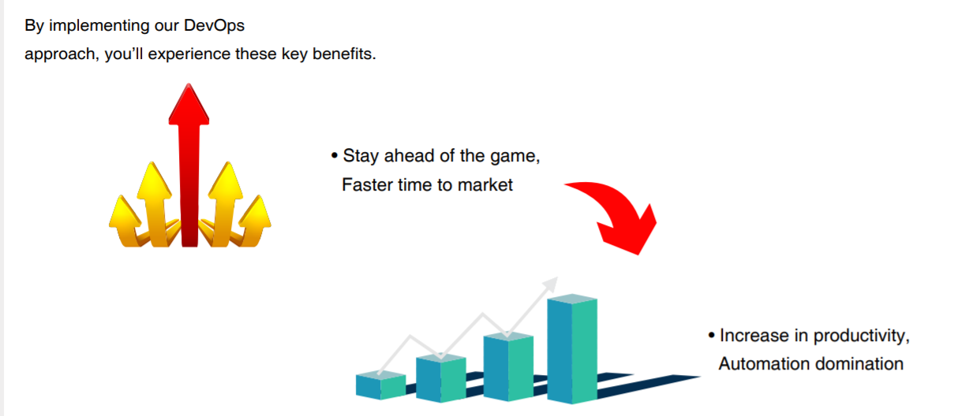

Slide 16
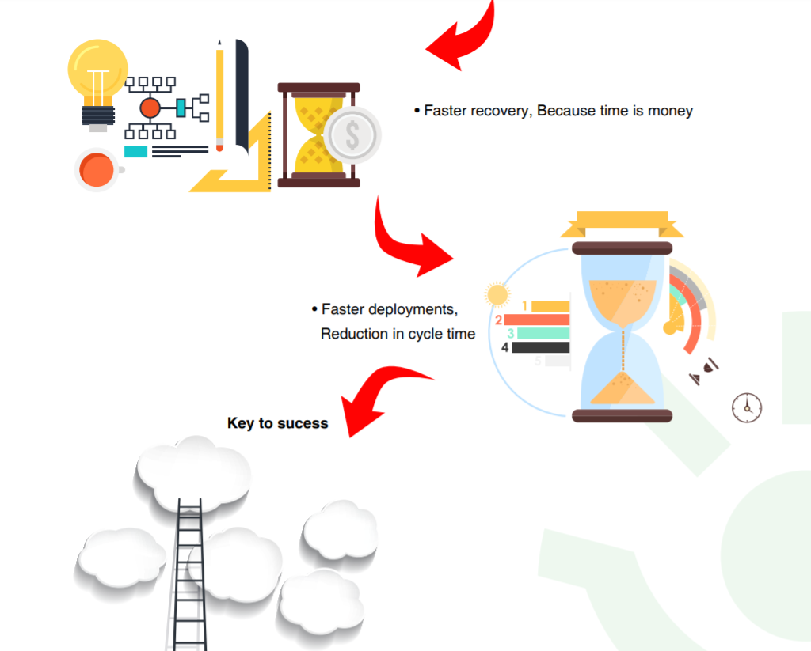
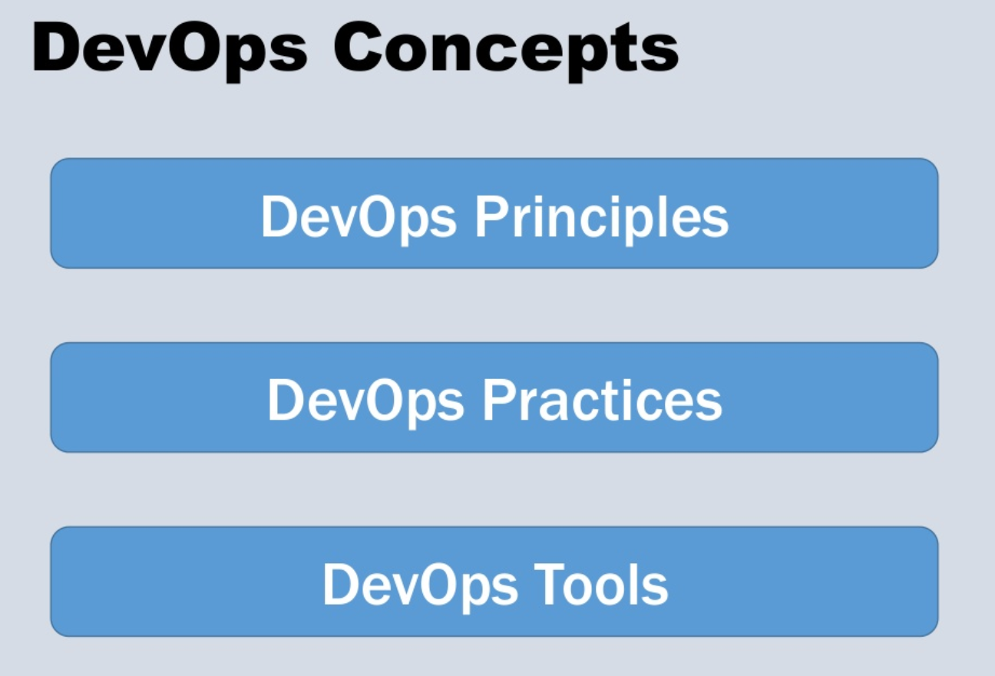

Slide 17
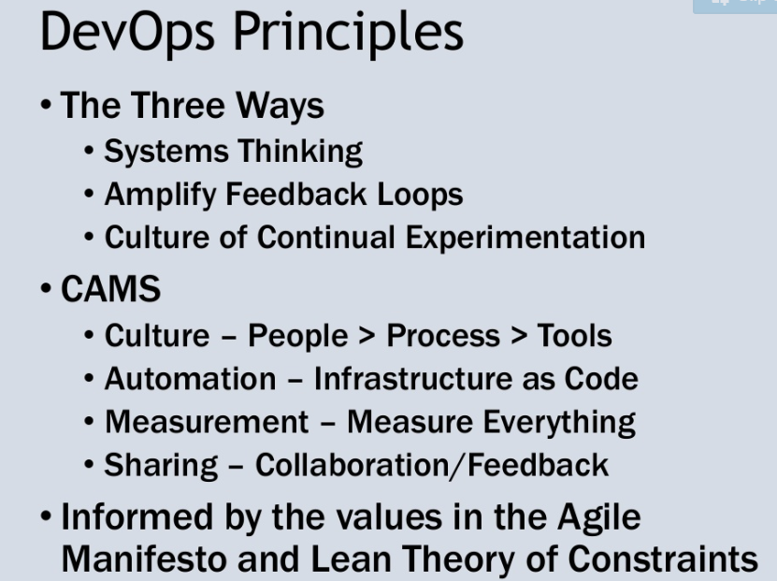

Slide 18
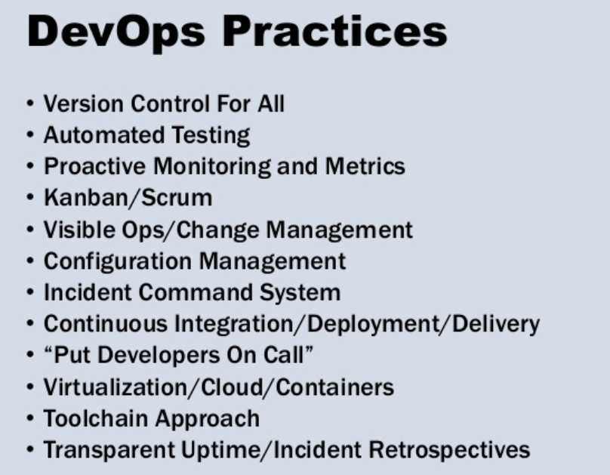

Slide 19
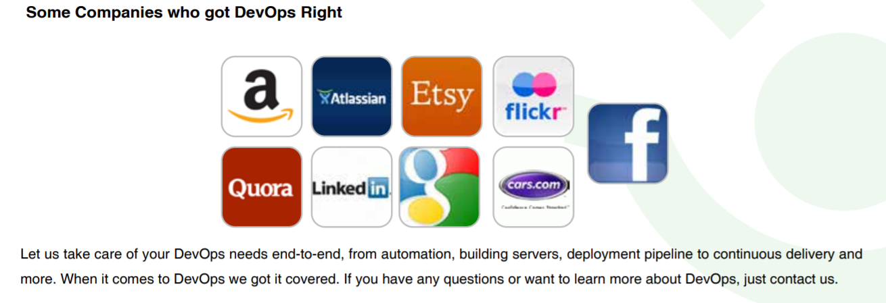

Slide 20
DevOps Roles
DevOps Engineer | DevOps Testers
DevOps Architect | DevOps Security specialists
DevOps Release Manager | DevOps Automation Experts
 | DevOps Lead
DevOps Testing Professional
If you want to become a DevOps testing professional, then you should have a testing background to excel in this domain. Some of the remarkable certifications for DevOps testing professionals are given as:
Selenium Certification by JanBask,
Test architect Masters Certification by JanBask,
ETL Testing certification by JanBask, and more.
He is the person responsible for writing automated test cases for applications in development. experience in testing domain. Sound knowledge of Selenium, Java, Python, and different type of testing can help to grow in this job profile.

Slide 21
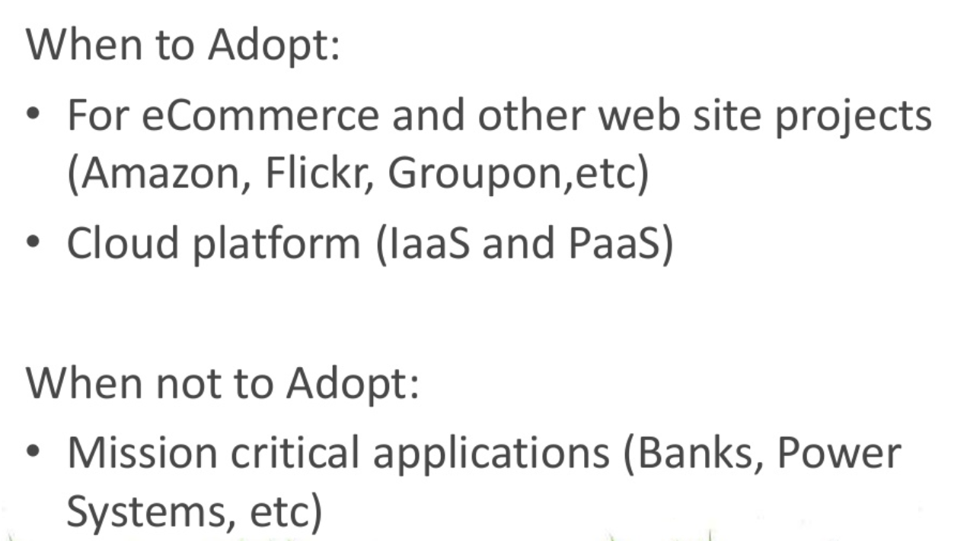
When to Adopt and when not to adopt

